Slide 1
Project 1 : A Pedestrian Alert System using “earables”
Team Members: Jingjie Wu, Xuchen Xue

Slide 2
Overall Project Goals and Specific Aims
Use the audio information to recognize the approaching cars and their direction
Make the IMU information to determine the position of user’s head
A mechanism to alert the user if user is not aware of the approaching vehicle

Slide 3
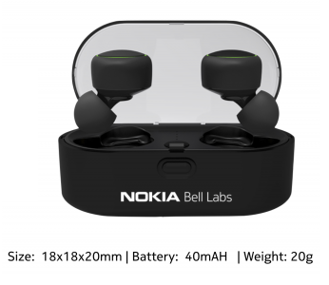
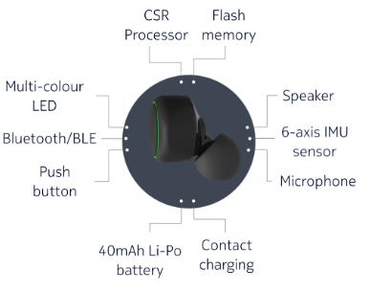
Technical Approach - Hardware
Phase 1:
Use Nokia eSense earables to collect audio information then perform certain algorithm to determine the direction of cars.
Problems:
Even though eSense earables have one microphone inside each earphone, only one microphone is activated while connecting to mobile phone via bluetooth.
We can’t connect two different pairs of eSense earables to the same phone because of the bluetooth protocal.
Nokia eSense earables

Slide 4
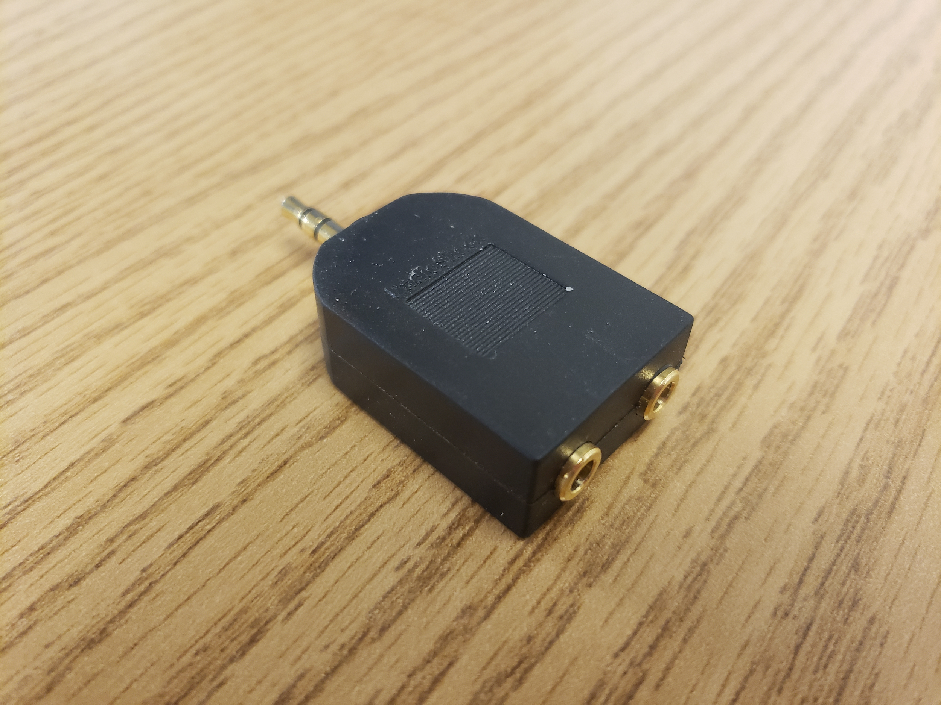
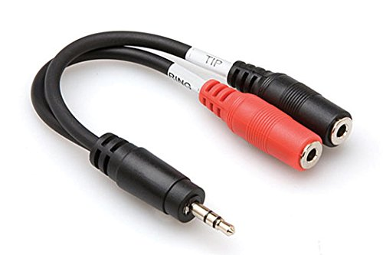
Technical Approach - Hardware
Phase 2: Use two wired microphones and a Y cable to record voices in stereo.
Problems:
First Y connector we used doesn’t split the input of two microphones, it add the input of two microphone together and average it to each channel.
Second Y cable also has similar problem. A review said that this Y cable could split the output perfectly but it can’t do anything to the input.
We finally realized that Android phone doesn’t has the ability to split audio input into two channel and we need special digital recorder which has more than two input ports.
Normal Y connector
Hosa YMM-261 3.5 mm TRS to Dual 3.5 mm TSF Stereo Breakout Cable

Slide 5
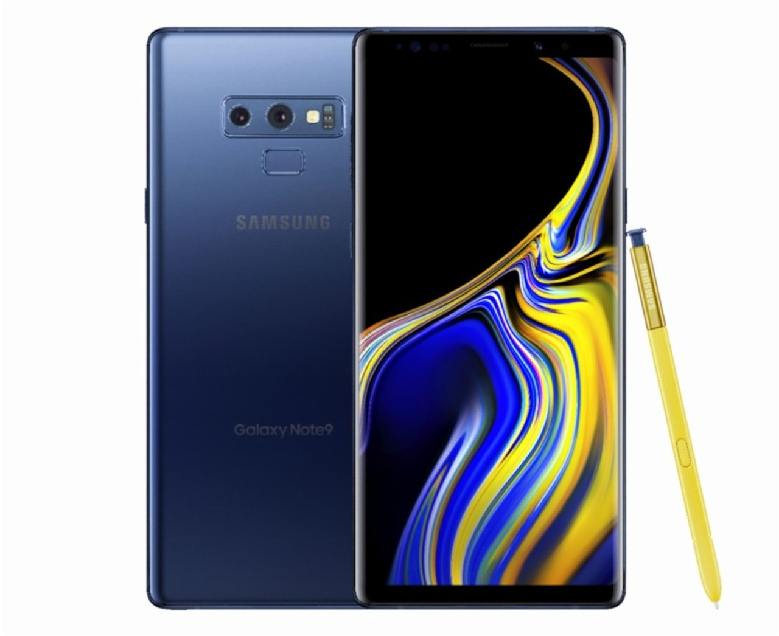
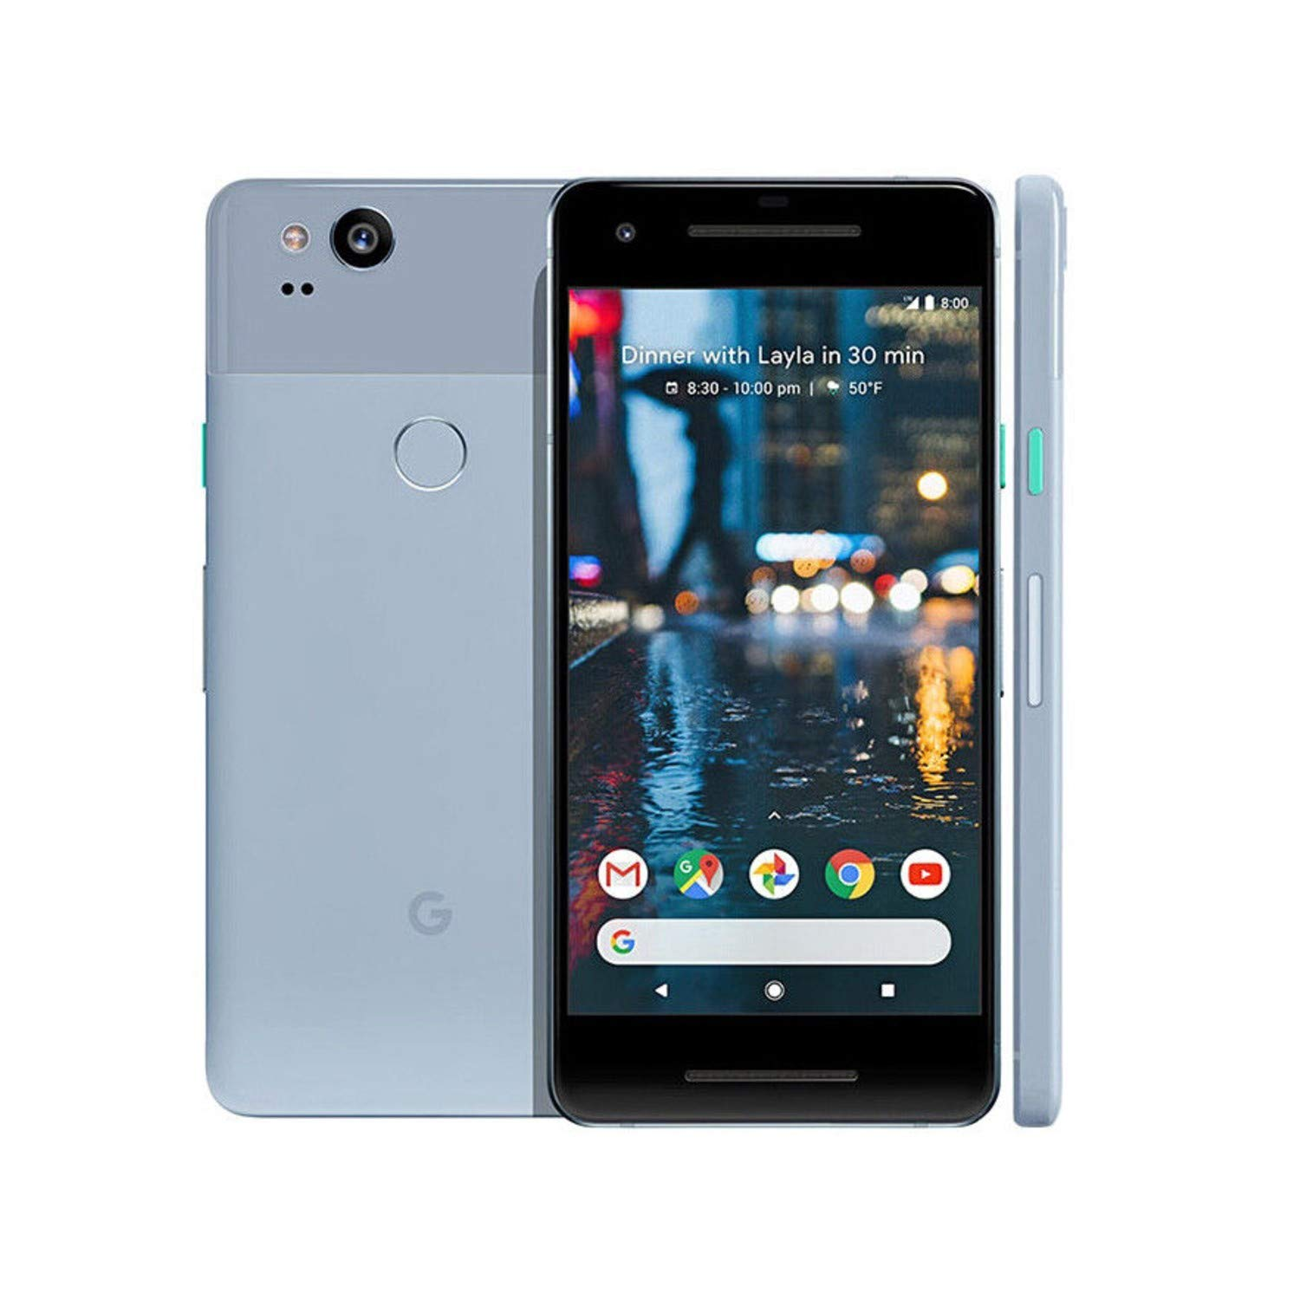
Technical Approach - Hardware
Phase 3: Use two Android phones to record voice separately and use a tone generator as a mark, then analyze voice samples offline
Potential Problems:
Since tone generator generates a mark at frequency domain and we mainly do analysis in time domain, we need to careful choose the length of frame. If the frame length is too long, it will reduce the accuracy of detecting the latency between two microphones. If the frame length is too short, it will reduce the accuracy of car noise detection.
The audio files recorded by two different phone could be slightly different with same sampling rate(44 kHz)
Samsung Note 9
Google Pixel 2

Slide 6
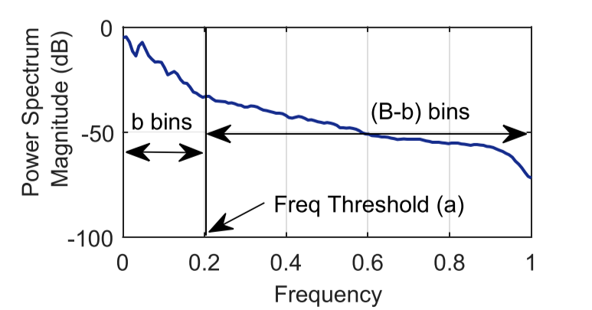
Technical Approach - Signal Processing
Data: From recorded audio, take 100ms frame and 2ms slides in order to detect the difference
Feature: Non-Uniform Binned Integral Periodogram (NBIP)

Slide 7
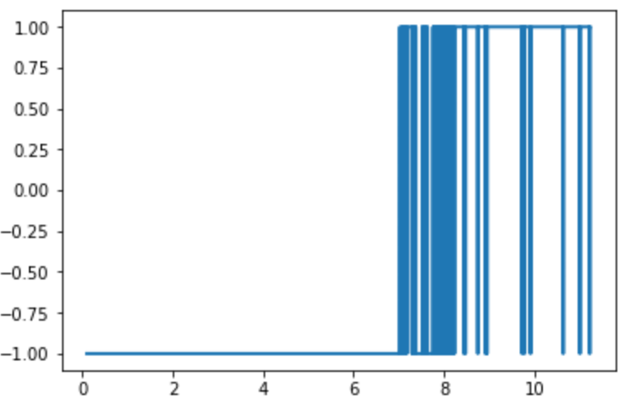
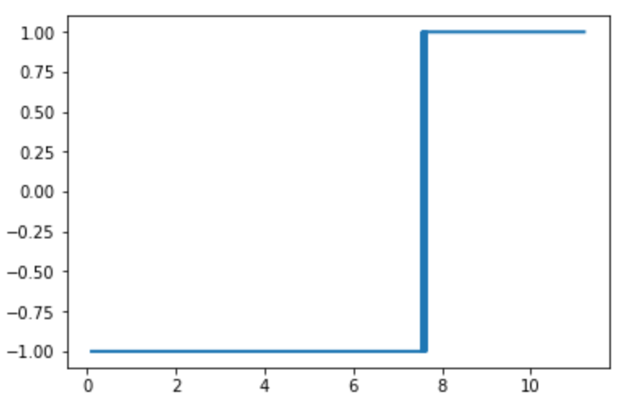
Technical Approach - Model Training
Model: OneClassSVM Isolation Forest
Test:
Better
Notes:
Not so accurate: 1. Sample data not good
2. Number of data too small

Slide 8
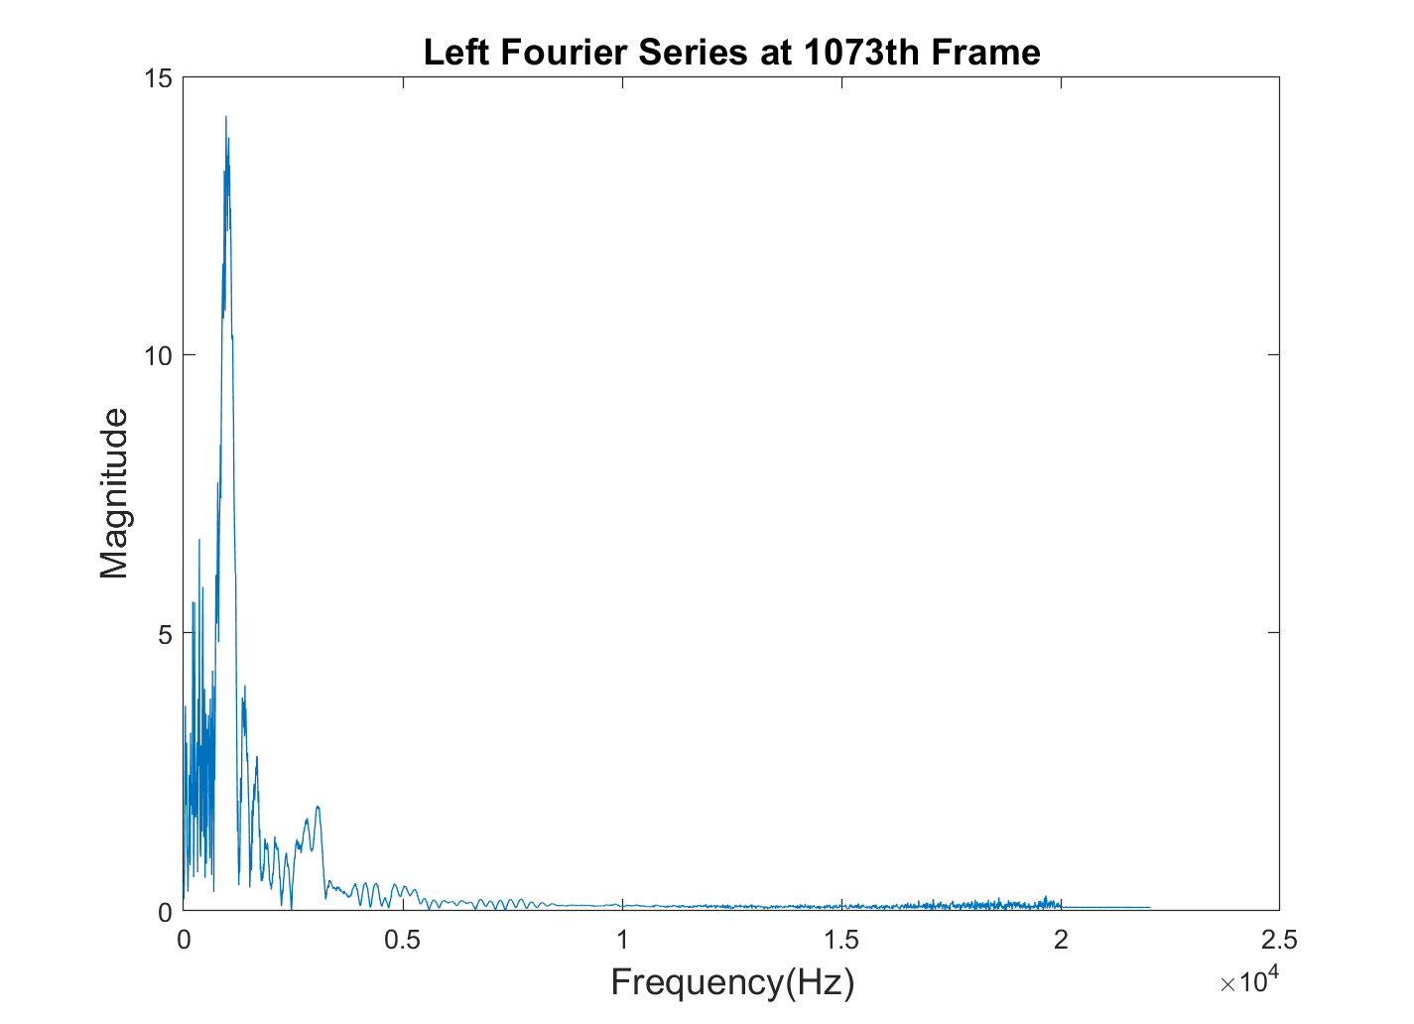
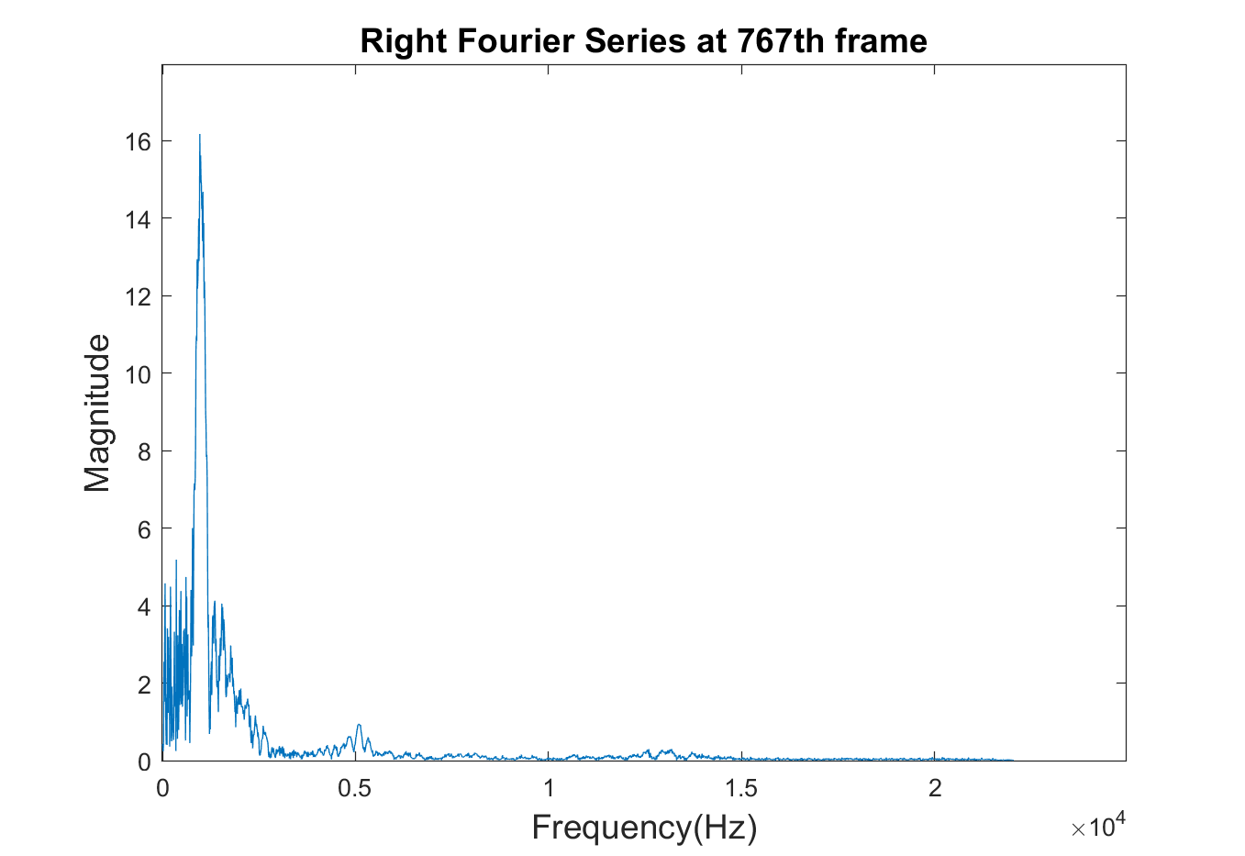
Technical Approach - Synchronization
Approach: Detect the 1kHz tone in each channel and then compute the difference by checking if a peak occurs at 1kHz frequency in Fourier Series
Dt = (1073-767)*T_slide = 0.555102s

Slide 9
Technical Approach - Result
In summary, we are able to detect the car and determine its direction only by left or right since we only have 2 microphones.
For each channel, detect the car noise by Isolation forest model and then make the difference to get the relative delay.
Combine the relative delay with the synchronization time to get the real delay.
In this case, relative delay is (3912-3596)*T_slide = 0.573243s = Right - Left
The final result is 0.573243-0.555102 = 0.018141s
Right comes first, which means car is on the right hand side, consistent with our sample
Notes:
Not so accurate

Slide 10
Current Status and Next Steps
Current Status:
We are still working on car noise detection part and we are extracting more features of car noise to improve our accuracy even in a short frame.
Record more audio sample to make our car noise detection mechanism more robust.
Extract head information from eSense IMU unit
Next Steps:
Shrink the window size and modify the window overlap percentage to optimize direction detection
Combine the information of IMU and output of MATLAB to develop a alert mechanism

Slide 11
Reference
[1] de Godoy, D., Islam, B., Xia, S., Islam, M. T., Chandrasekaran, R., Chen, Y. C., ... & Jiang, X. (2018, April). Paws: A wearable acoustic system for pedestrian safety. In 2018 IEEE/ACM Third International Conference on Internet-of-Things Design and Implementation (IoTDI) (pp. 237-248). IEEE.
[2] S. Xia et al., "A Smartphone-Based System for Improving Pedestrian Safety," 2018 IEEE Vehicular Networking Conference (VNC), Taipei, Taiwan, 2018, pp. 1-2.

